Slide 1

ITA0602 – MACHINE LEARNING
Technical presentation
GUIDED BY:-DR ANAKATH ARASAN
Presented by
NAGARAJAN SUBHASH (192312489)

Slide 2
ENSEMBLE LEARNING
Ensemble learning is a machine learning technique that combines the predictions of multiple models to produce a stronger and more accurate final prediction.
Importance
Improves accuracy: Combining multiple models can produce more reliable predictions than a single model.
Reduces errors: It can reduce problems such as high variance and high bias.
Improves robustness: The final prediction is less dependent on the weaknesses of one individual model.
Better generalization: Ensemble methods can perform well on unseen data.
Useful in real-world applications: They are widely useful for classification, prediction, recommendation, fraud detection, and other machine learning tasks.

Slide 3
Feature Selection Techniques & PCA
Filter Methods
Multiple Models: Uses several individual models called learners.
Model Combination: Combines their outputs to obtain the final result.
Higher Accuracy: Multiple predictions can produce better results.
Wrapper Methods
Bagging: Trains multiple models independently and combines their predictions.
Boosting: Builds models sequentially, giving more attention to previous errors.
Stacking: Combines different models using another model to make the final prediction.
Embedded Methods
Trains multiple models independently using different samples of the dataset.
Combines their predictions to produce a final result.
Principal Component Analysis (PCA)
Combines predictions from different types of machine learning models.
A final model, called a meta-learner, learns how to combine their predictions.
Can improve overall predictive performance.

Slide 4
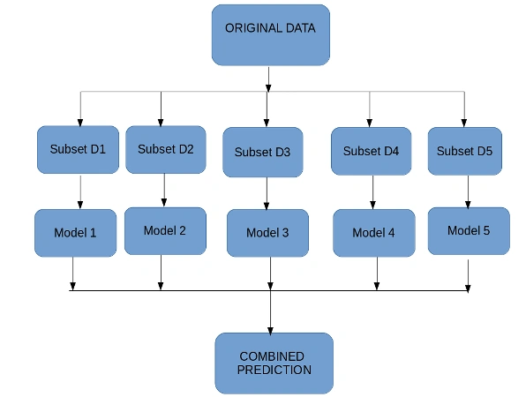

Slide 5
Model Evaluation Techniques
Model evaluation determines how well a machine learning model performs on unseen data.
Techniques
Train-Test Split: Divides data into training and testing sets.
Cross Validation: Uses K-folds for reliable evaluation.
Bootstrapping: Random sampling with replacement for small datasets.
Provides unbiased performance estimation.
Helps compare different models effectively.

Slide 6
Performance Metrics & Validation
Classification Metrics
Accuracy
Precision
Recall
F1-Score
Confusion Matrix
ROC Curve
Regression Metrics
MAE
MSE
RMSE
R² Score

Slide 7
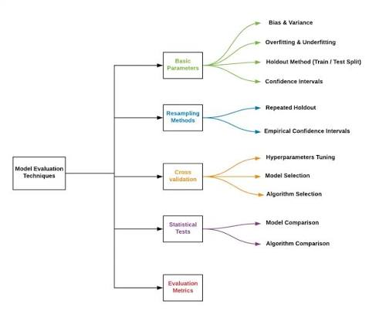

Slide 8
Data Preprocessing, Post-Processing & Evaluation
Data Preprocessing, Post-Processing and Evaluation is the process of preparing raw data, refining the model's output, and measuring the performance of a machine learning model to ensure accurate and reliable results.
Performance Metrics
Improves the quality and consistency of machine learning data.
Removes errors and unwanted information from datasets.
Helps the model learn important patterns and features.
Improves model efficiency and performance.
Makes the final results easier to interpret and visualize..

Slide 9
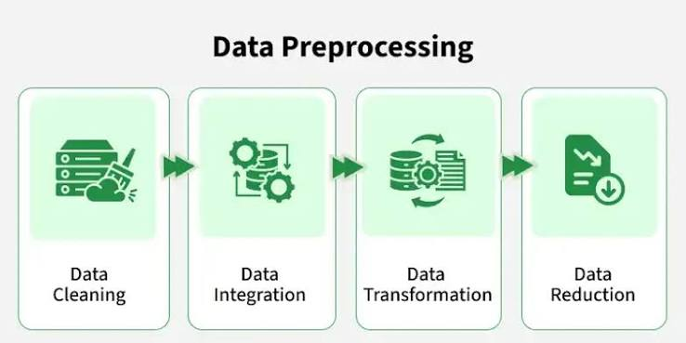
Merits
Accuracy – Measures the proportion of correct predictions.
Precision – Measures the correctness of positive predictions.
Recall – Measures how many actual positive cases are identified.
F1-Score – Combines precision and recall.
Cross-Validation – Checks model robustness and generalizability.

Slide 10
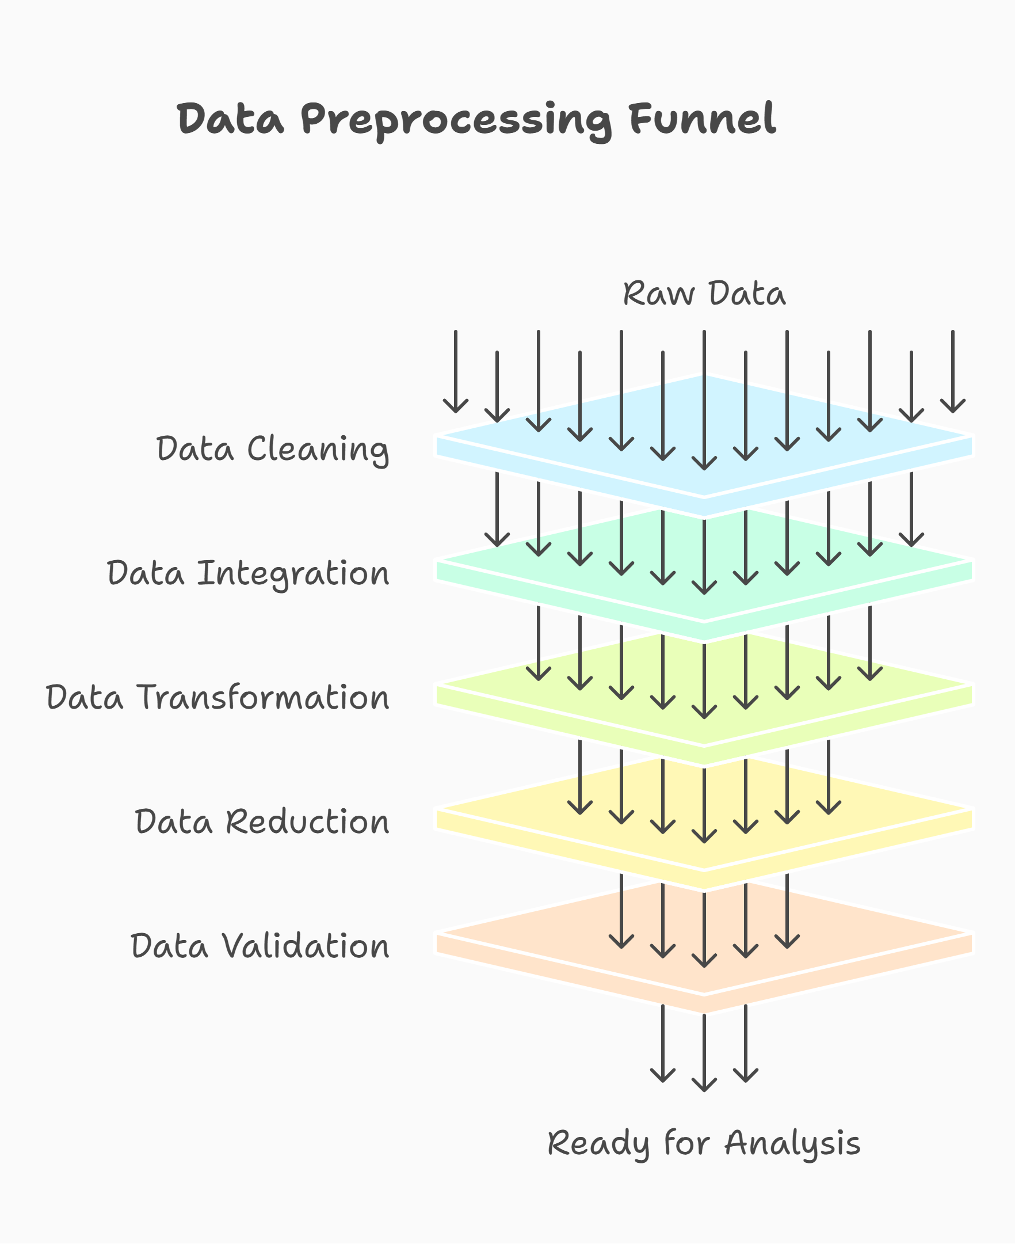

Slide 11
Future Scope and Publication Potential
Machine learning systems continue to evolve with advancements in AI and data processing.
Future Enhancements
Use larger and more diverse datasets.
Integrate real-time data processing.
Apply Deep Learning techniques.
Develop hybrid and ensemble models.
Deploy on cloud and edge computing.
Improve explainability using Explainable AI (XAI).

Slide 12
Publication Potential
Research work can be converted into a journal or conference paper using a structured format.
Research Paper Structure
Abstract
Introduction
Literature Review
Methodology
Results & Discussion
Conclusion
References
Benefits
Academic recognition.
Knowledge sharing.
Supports future research.

Slide 13
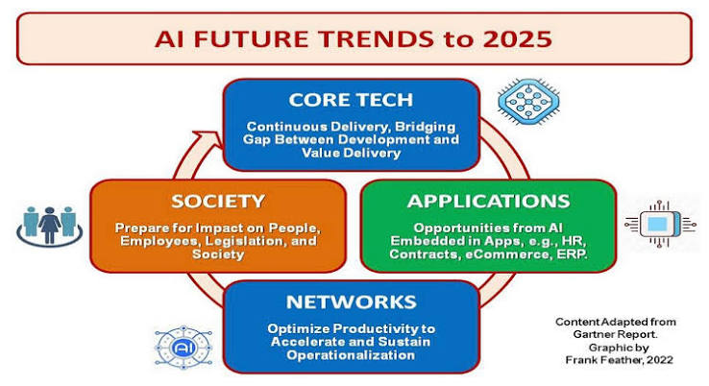

Slide 14
Concept Learning and Hypothesis Representation
Concept learning is the process of learning a general concept or rule from a set of training examples. A hypothesis represents a possible rule that can be used to classify or describe the examples.
Types
Helps machines learn concepts from training examples.
Supports classification problems.
Helps discover useful patterns and rules from data.
Provides a structured way to represent possible solutions.

Slide 15
Learning Perspectives & Challenges
Learning Perspectives
Symbolic Approach: Uses logical rules and knowledge representation.
Statistical Approach: Uses probability and data-driven models.
Challenges
Poor data quality.
Overfitting and underfitting.
Computational complexity.
Scalability.
Feature selection and preprocessing.

Slide 16
